Slide 1

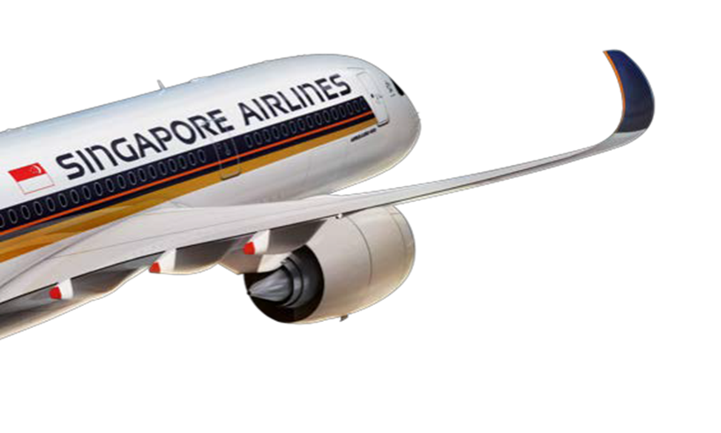
INTERIM PROJECT
By The Data Triad
Singapore Airlines Customer Satisfaction Analysis

Slide 2
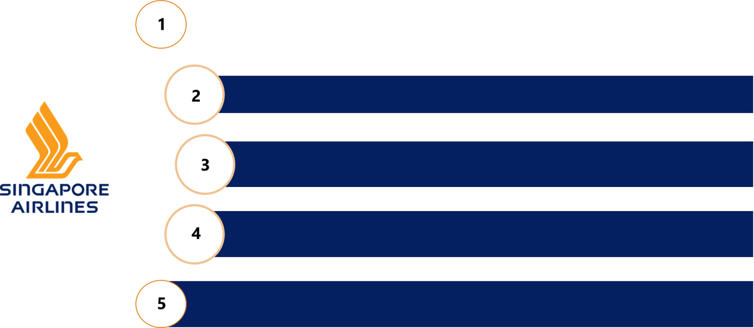


CONTENTS PAGE
PROJECT GOALS
DATA SOURCES
METHODOLOGIES
ANALYSIS & CHALLENGES
CONCLUSION

Slide 3


PROJECT GOALS
📋 Project Overview:
🔍 Extract reviews from the Skytrax website for Singapore Airlines
🧹 Transform and clean the review data
💡 Perform sentiment analysis
🛢️ Load the processed data into a PostgreSQL database for further exploration and analysis
🎯 Objectives:
🛠️ Develop a Python-based web scraper to extract Singapore Airlines passenger reviews from Skytrax and save them into a CSV file
📚 Familiarize with data tools and libraries like pandas, textblob, sqlalchemy, matplotlib, and seaborn for ETL and EDA
🧱 Design and build a relational database with a schema, tables, and an Entity-Relationship (ER) model
💾 Use SQL scripts to populate the database with clean, normalized data

Slide 4
DATA SOURCE
Website: Skytrax Airline Reviews
URL: https://www.airlinequality.com/airline-reviews/singapore-airlines/
Data Collected
Reviewer's name and overall rating
Review title and full review text
Trip metadata: type of traveller, seat class, route, and date flown
Sub-category ratings: food, service, entertainment, comfort, etc.
Binary field: “Would recommend” (Yes/No)

Slide 5
TECHNOLOGIES USED
Language: Python
Packages:
requests, BeautifulSoup - HTML parsing and data extraction
pandas - Cleaning, transformation, CSV management
TextBlob, wordcloud - Sentiment scoring and visualization
matplotlib, seaborn - Sentiment and rating trend analysis
sqlalchemy - Schema creation and data transformation
Environment: Jupyter Notebook

Slide 6
ETL - EXTRACTING DATA
Data Extraction Process
For our web-scraper, we used requests to fetch HTML pages from Skytrax review pages.
Parsed HTML with BeautifulSoup to extract review details like:
🧑 User name
⭐ Overall rating
📝 Review title and content
✈️ Trip status, type of traveller, seat type, route, and date flown
Handled pagination by:
Looping through 100 pages of reviews
Grabbing reviews from each page one at a time
Sleeping for 15 seconds after each request to avoid overwhelming the server

Slide 7
ETL - CLEAN DATA
Handling Missing Data:
Convert missing values (NaNs) in fields like ‘Route’, ‘Type of Traveler’
Impute missing values with appropriate defaults (eg. ‘Unknown’, ‘0’)
Dropping Unnecessary Columns:
Remove irrelevant fields to streamline data and analysis
Focus on essential features such as ‘Detail Reviews’, ‘Overall Rating’, ‘Seat Type’
Standardizing Text:
Preprocess the ‘Detail Review’ column for sentiment analysis.
Clean and prepare data for further processing by TextBlob.

Slide 8
ETL - TRANSFORM DATA
Preparing Data for Storage
Clean and standardize data for PostgreSQL compatibility
Convert 'Date Flown' to DateTime
Standardise Column Names, Used lowercase + underscores
Convert 'Recommended' to Boolean
Converted data types (e.g., int → SMALLINT, float → NUMERIC).
why these transformations?
Improves Readability, Helps avoid errors when writing queries
Names with spaces/symbols can cause issues with SQLAlchemy
Proper Date Handling in PostgreSQL
Boolean type more intuitive than 0/1 for logical checks

Slide 9
ETL - LOAD DATA
Loading Data to Postgresql
Created a new PostgreSQL database with two schemas:
sia_source for clean/transformed data
sia_normalised for normalized tables
2. Loaded transformed data to the sia_source schema
3. Normalized the data and populated relational tables in the sia_normalised schema using SQL scripts

Slide 10
DATABASE DESIGN
Schema Overview
Two PostgreSQL schemas:
sia_source: stores clean, transformed data
sia_normalised: stores our relational model
Why Normalise to 3NF?
Improve query efficiency
Eliminate redundancy
Support future scalability of the system (e.g., adding other airlines' reviews later)

Slide 11
TABLES
1. traveller_type - Stores unique traveller categories.
Primary Key: traveller_type_id
1 attribute - type_of_traveller
2. seat_type - Stores unique seat types mentioned in reviews.
Primary Key: seat_type_id
1 attribute - seat_type
3. sia_users - Stores review-level details including user name, rating, comments, and trip metadata.
Primary Key: sia_user_id (surrogate)
Foreign Keys:
traveller_type_id → traveller_type(traveller_type_id)
seat_type_id → seat_type(seat_type_id)
4. user_ratings - Stores sub-rating metrics such as seat comfort, food quality, staff service, etc.
Primary Key: rating_id (surrogate)
Foreign Key:
sia_user_id → sia_users(sia_user_id)

Slide 12
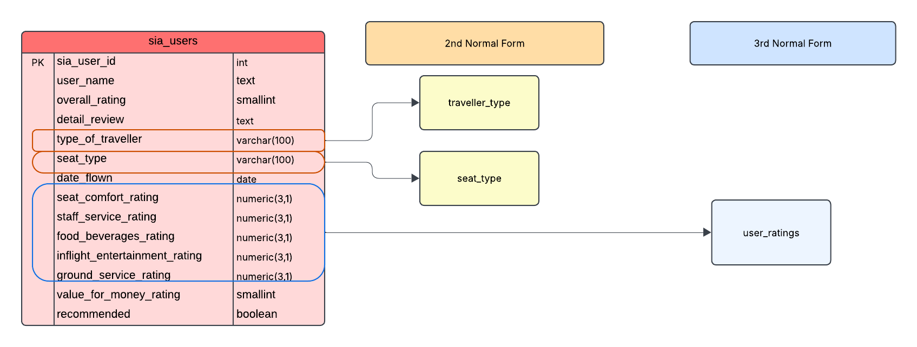
NORMALISATION

Slide 13
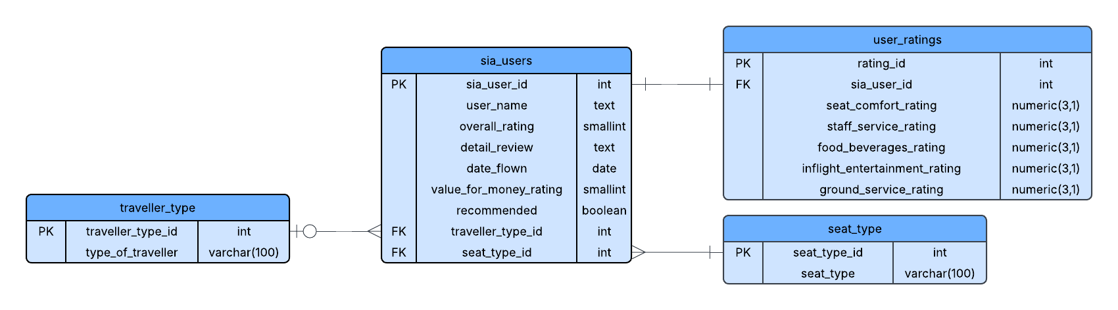
ERD DIAGRAM
Entity Relationships
One-to-Many from traveller_type to sia_users: One traveller type can be linked to multiple user reviews.
One-to-Many from seat_type to sia_users: One seat type can be associated with many users.
One-to-One from sia_users to user_ratings: Each user ID represents a unique review entry and has only one set of ratings.

Slide 14
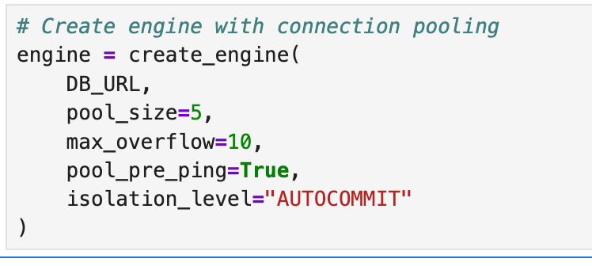
CHALLENGES FACED
Schemas Not Created in Target PostgreSQL Database
Problem: After creating the "interim_project" database, schemas like sia_source and sia_normalised were not being created despite no errors being thrown.
Root Cause: The default SQLAlchemy connection settings didn't maintain persistent or properly managed connections. This caused issues especially when multiple metadata operations (like CREATE SCHEMA, CREATE TABLE) were queued rapidly — the connection might be dropped or invalidated between operations. :
Solution: Implemented connection pooling using SQLAlchemy's create_engine() parameters:
pool_size=5 ensures at least 5 open connections are reused.
max_overflow=10 allows temporary overflow if needed.
pool_pre_ping=True validates a connection before using it — avoiding broken pipe issues.
isolation_level="AUTOCOMMIT" allows DDL statements like CREATE SCHEMA to execute without needing explicit commit() calls.

Slide 15
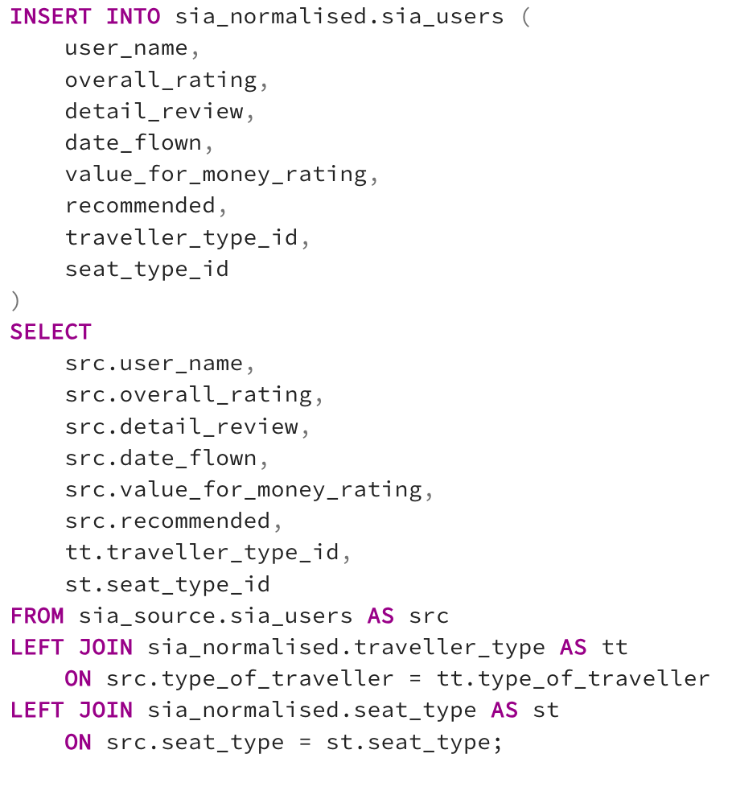
CHALLENGES FACED
2. Mapping Foreign Keys from Source to Normalized Tables
Problem: Needed to replace string values (type_of_traveller, seat_type) in sia_source.sia_users with integer foreign keys (traveller_type_id, seat_type_id) during insertion into sia_users.
Solution: Used LEFT JOINs to efficiently and clearly fetch the correct traveller_type_id and seat_type_id from the lookup tables (traveller_type, seat_type) during insertion into sia_users.

Slide 16
IMPROVEMENTS
Introduce Star Schema for Analytics - While the current Entity-Relationship Diagram (ERD) and normalized database design are ideal for maintaining data integrity and scalability, future expansion into business intelligence (BI) tools or dashboarding may benefit from implementing a star schema.
This would involve creating a fact table (e.g., fact_reviews) to capture measurable events such as sentiment scores and ratings.
Related dimension tables (e.g., dim_airline, dim_date) can provide context to support faster and more flexible queries.
A star schema structure simplifies analytical queries, improves performance in BI tools like Tableau or Power BI, and supports trend reporting and aggregations more efficiently.
Add Support for Multi-Airline Reviews - Extend the schema to include an airline table and associated foreign key in sia_users to support scraping and storing reviews for multiple airlines beyond Singapore Airlines.

Slide 17
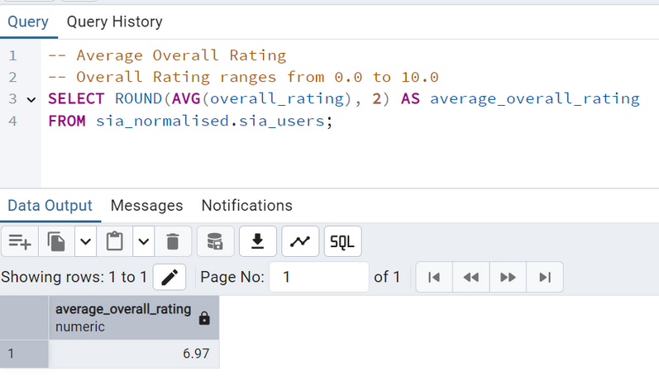
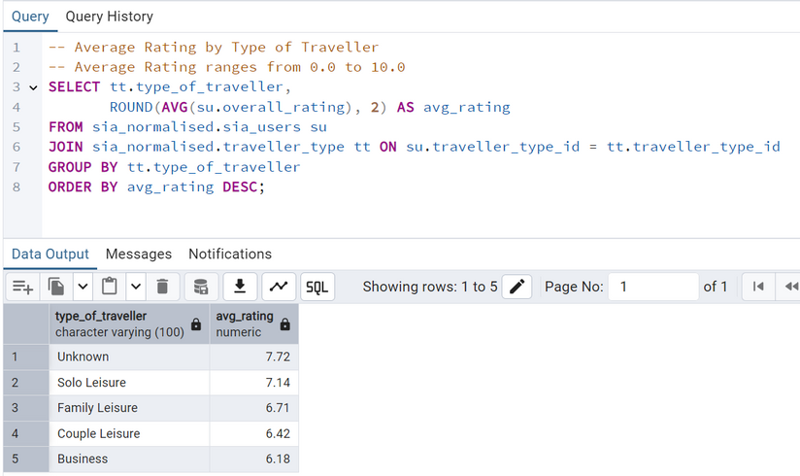
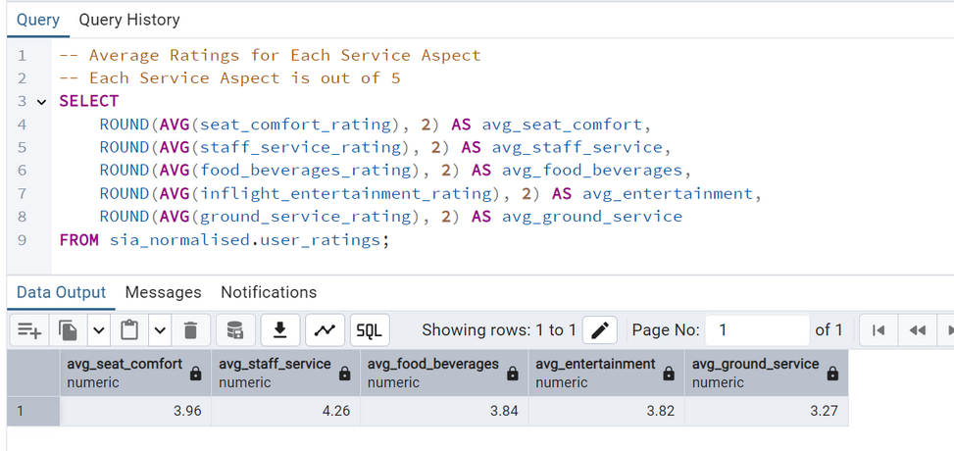
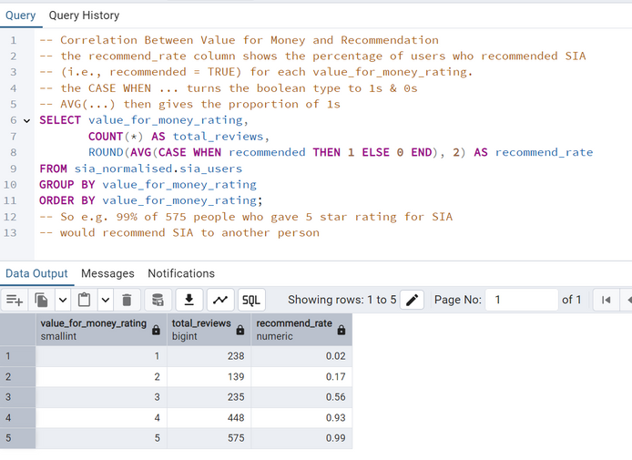
SQL QUERIES EXAMPLES

Slide 18
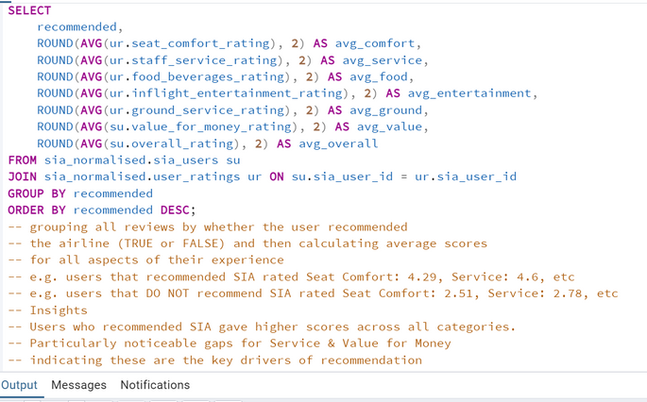
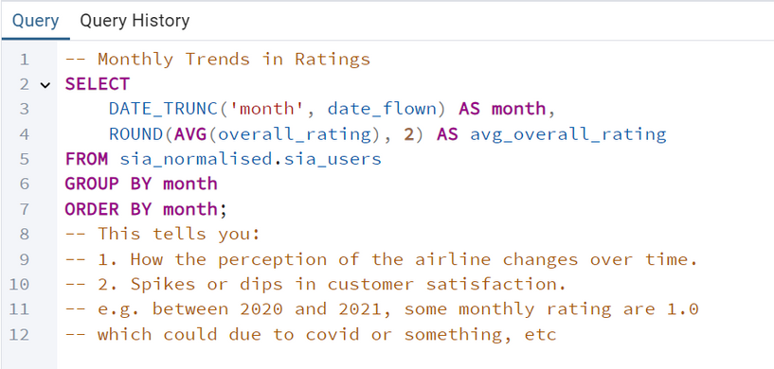
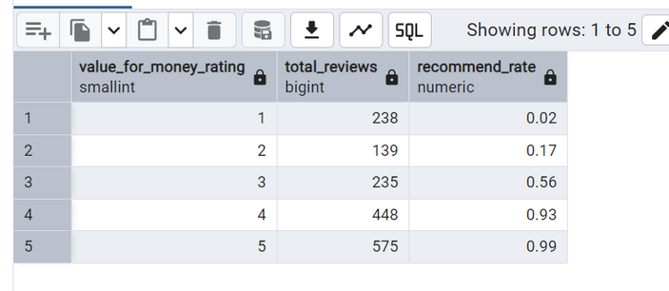
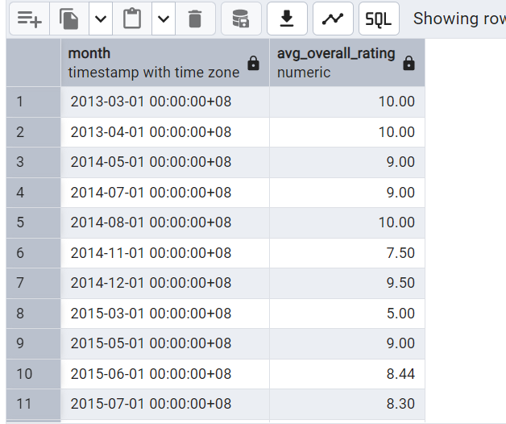
SQL QUERIES EXAMPLES

Slide 19
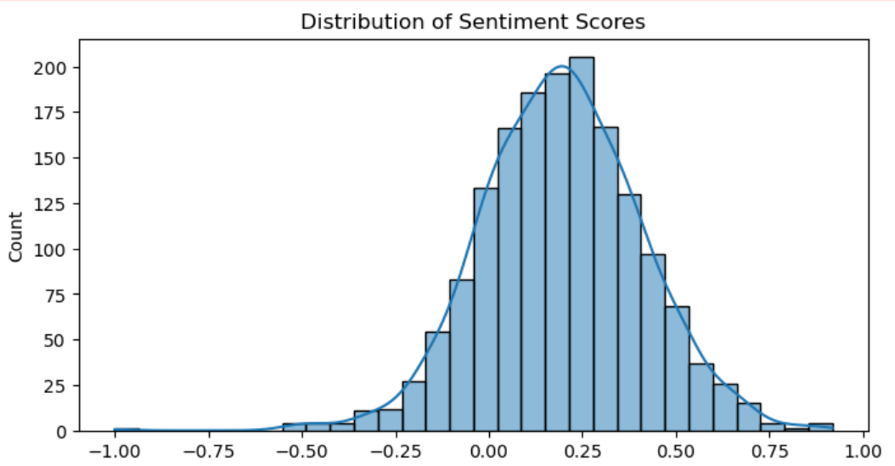
POINTS OF INTEREST
Sentiment Distribution:
Avg sentiment score: 0.19 (slightly positive)
Indicates general satisfaction with room for improvement.

Slide 20
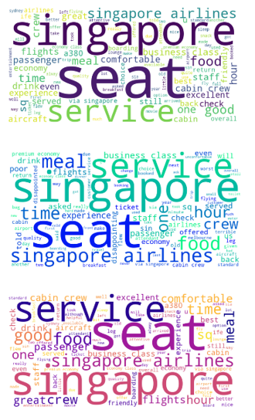
POINTS OF INTEREST
Word Cloud Insights:
Negative reviews highlight terms such as ‘delay’, ‘poor’ and ‘uncomfortable’.
Positive reviews frequently mention terms like ‘friendly’, ‘comfortable’ and ‘excellent’.
Overall
Negative
Positive

Slide 21
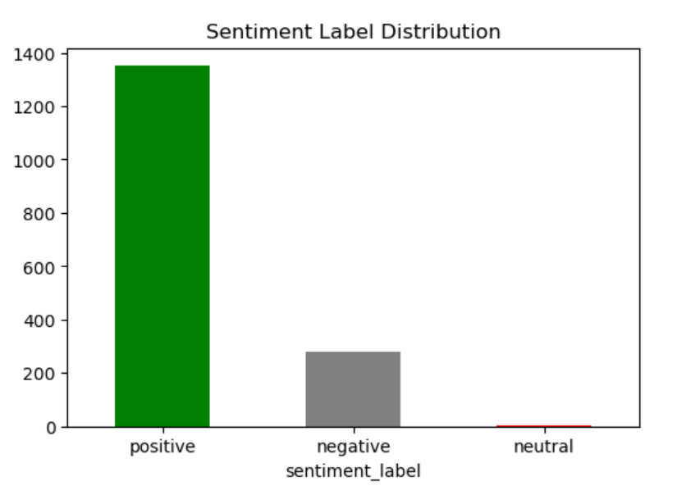
POINTS OF INTEREST
Sentiment Label Distribution
Negative Feedback Highlights:
Common issues include:
Flight delays
Poor Service
Uncomfortable seating
Positive
Negative
Neutral

Slide 22
NEXT STEPS
Automating the ETL Process & Validation
ETL Automation : Airflow, Cron Jobs or AWS Lambda to schedule ETL jobs
Ensure regular updates (weekly/monthly)
Data Validation
Schema Validation: Check columns and data types.
Completeness & Consistency : Handle missing values, duplicates.
Accuracy : Validate ratings.
Website Scraping:
Use retry mechanism to avoid blocks.

Slide 23
CONCLUSION
Learnings:
Planning the technicality of the projects to enable downstream "users" a smoother workflow. (E.g Data type, Documenting codes, best practices.)
Learning how to design a database from scratch, then query it using SQL.
Incorporating BSM:
We leveraged each other strengths by communicating to complete projects within tight deadline.
BSM lessons taught us to communicate our limitations tactfully to the team and helped us become more proactive when searching for workarounds.
THANK YOU FOR YOUR ATTENTION

